Slide 1


Application Interface Enhancement:
HealthPass
Seng474 – Term Project
Mesude Gökpınar 202028016
Duru Karacan 202128022
Hikmetcan Altaş 202011017

Slide 2
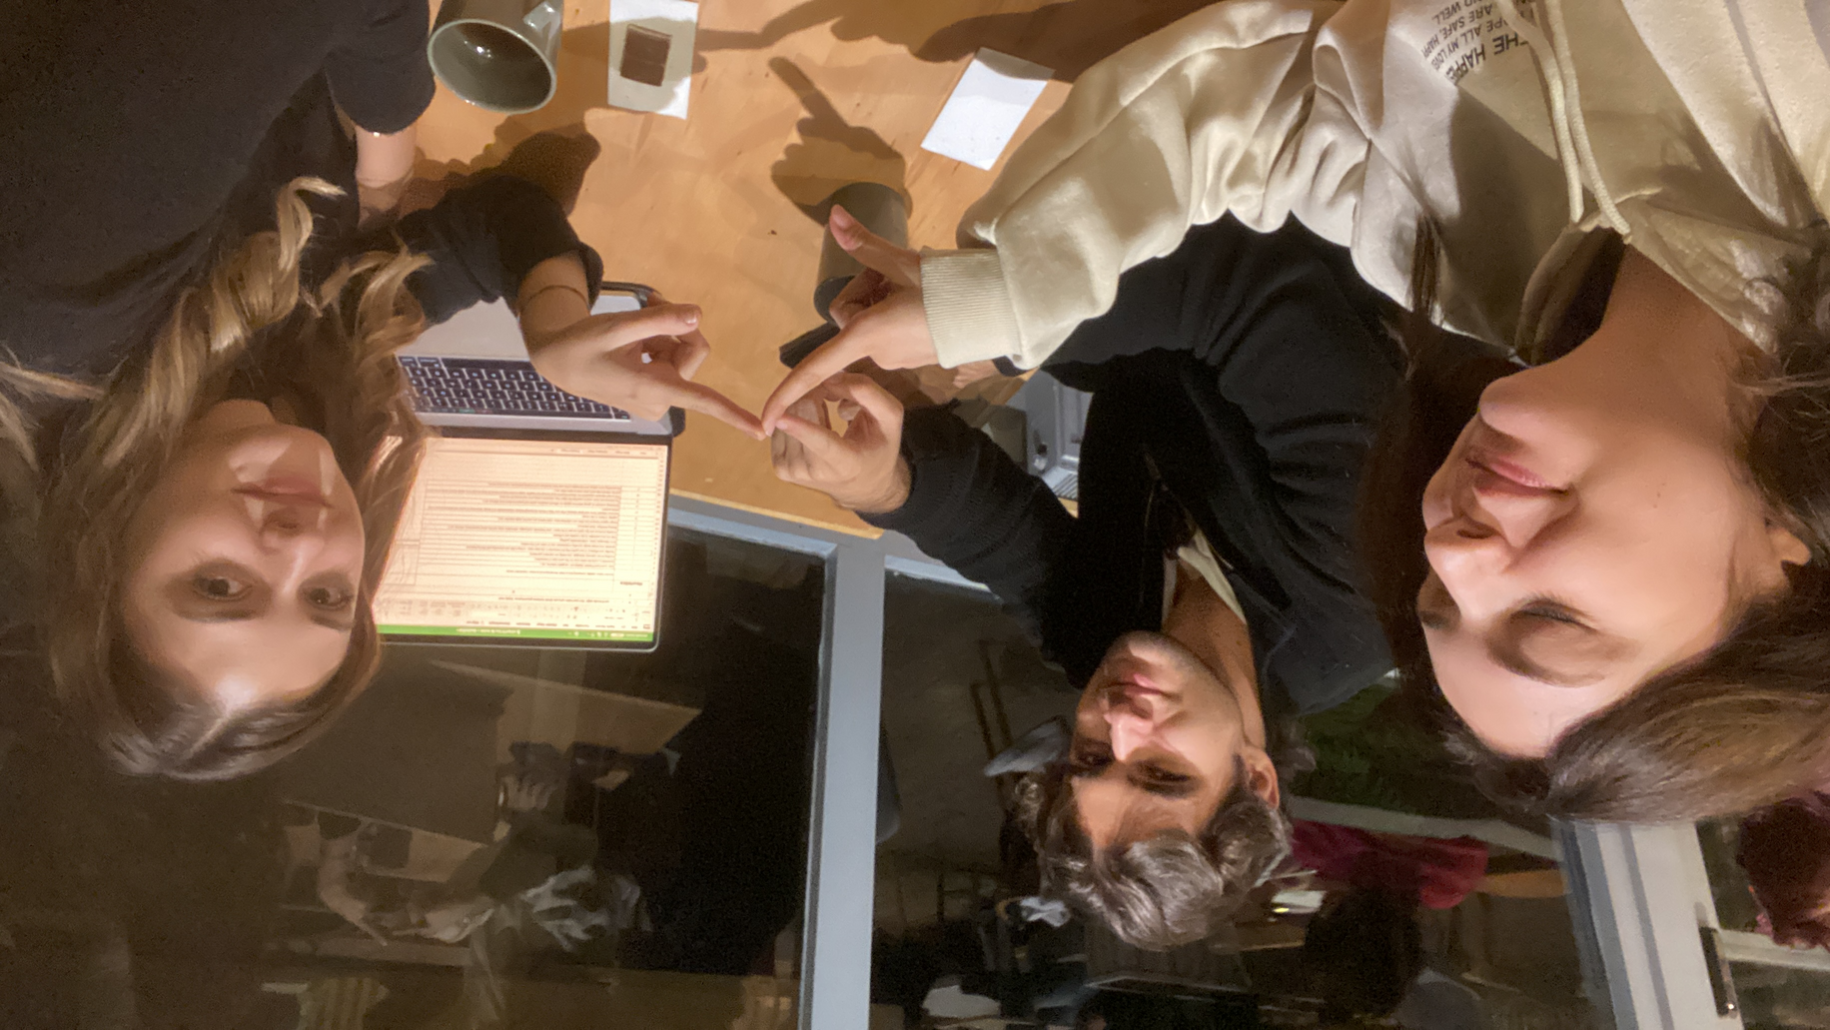
Team Structure
TEAM MDH
Our Team Name: MDH
Team Lead:
Mesude Gökpınar
- student of Software Engineering
Usability Tester:
Duru Karacan
- student of Software Engineering
Technical Analyst:
Hikmetcan Altaş
- student of Computer Engineering

Slide 3
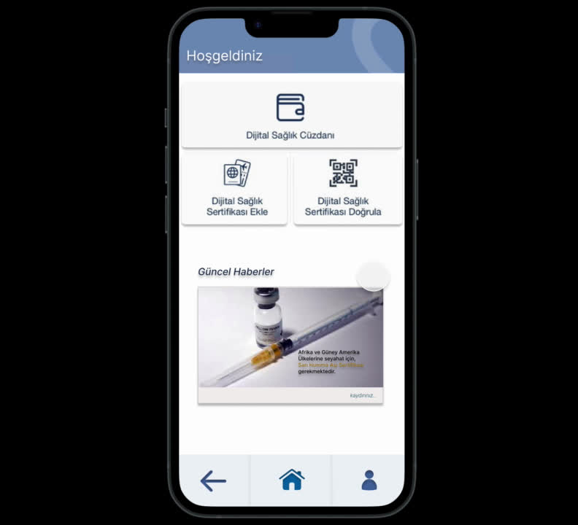
FIGMA TUTORIAL
Updated Health Pass Application tutorial for first time users
12/18/2023
3

Slide 4
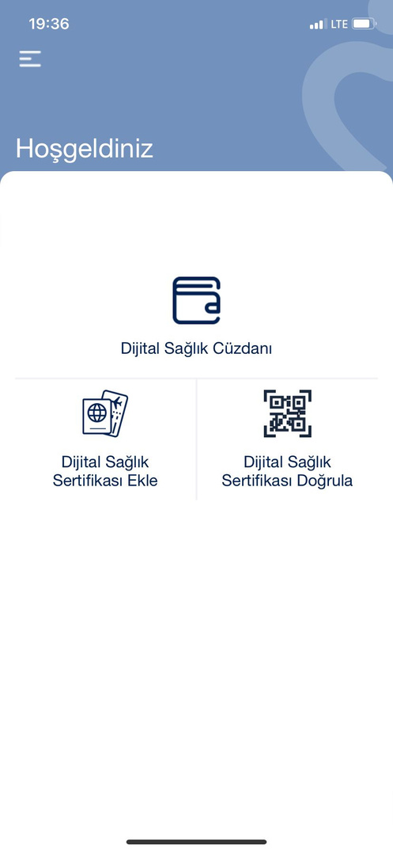
Our Rec. for welcome page:
Problem 1: A user session is not created
Solution: A user profile can be established, encouraging the user to adopt the application.
Added Extra Feature 1: A scrolling agenda box can be added to the homepage to inform users about the health certificates they need to have when visiting different countries, and a search box can be included for research purposes.
Added Extra Feature 3: Navigation bar, for easy navigation at the bottom of the page; home, user profile, and back buttons can be added.

Slide 5
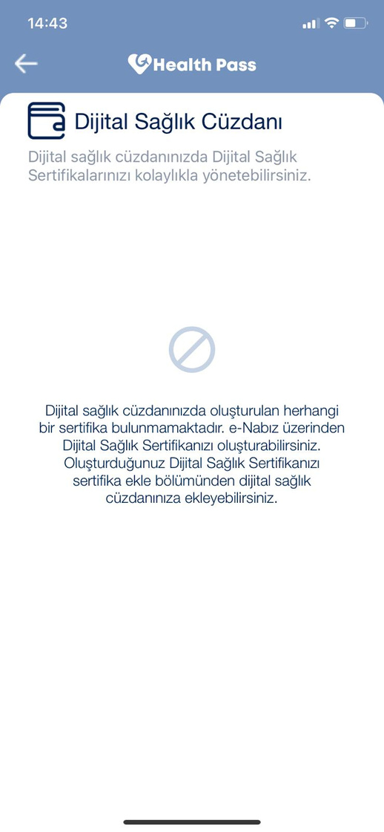
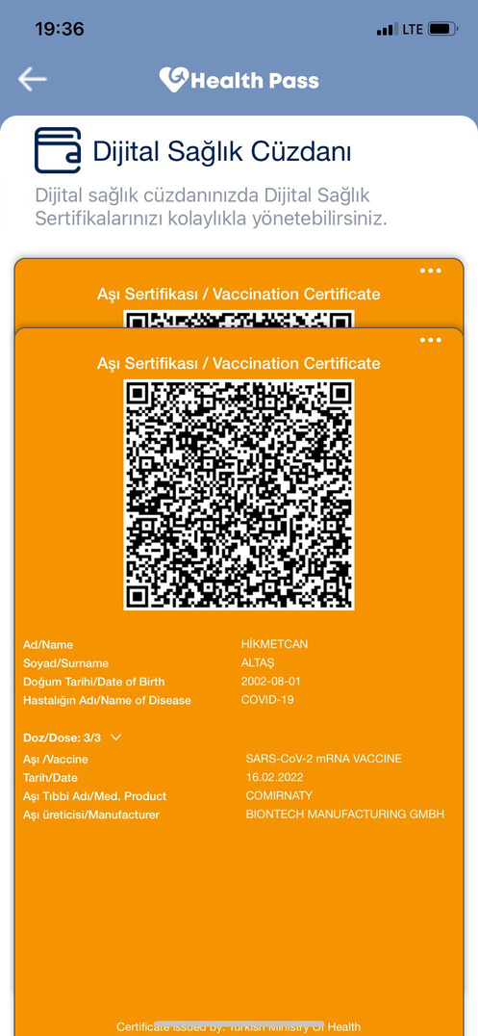
Our Rec. for digital health wallet screen:
Problem 1: When entering the page, it mentions the ability to add certificates via e-Nabız, but there is no link or clickable area directing to e-Nabız.
Solution: An Connect with e-Nabız extension can be added. To further streamline this process, allowing users to import certificates without hassle.
Problem 2: After adding certificates, selecting and checking certificates becomes challenging, especially when multiple categories of certificates are added.
Solution: A filtering and sorting section should be placed above to make it easier to find the desired certificate when multiple categories are present. Additionally, to facilitate the direct selection of the desired certificate, different listing options for certificates should be introduced.
Added Extra Feature 1: Navigation bar, for easy navigation at the bottom of the page; home, user profile, and back buttons can be added.

Slide 6
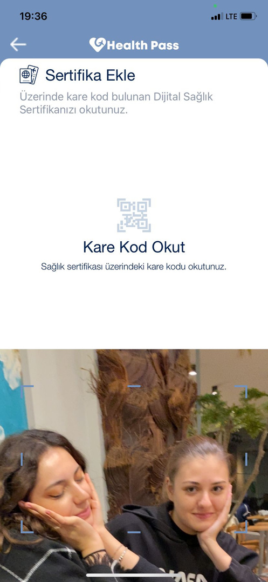
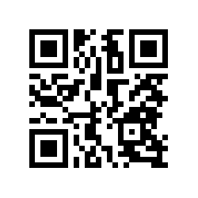
Our Rec. for Scanning Sertificate:
Problem 1: There is no warning when the QR code is incorrect or invalid while scanning.
Solution: A prompt for such cases can be quickly implemented to provide feedback.
Added Extra Feature 1: When adding a certificate here, a few alternative options to the QR code can be included (such as a written encrypted version of the QR code).
Added Extra Feature 2: A button for e-Nabız can also be added here.
Added Extra Feature 1: Navigation bar, for easy navigation at the bottom of the page; home, user profile, and back buttons can be added.

Slide 7

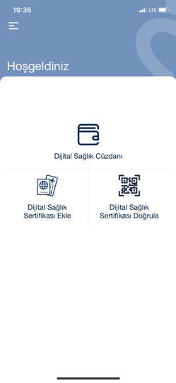
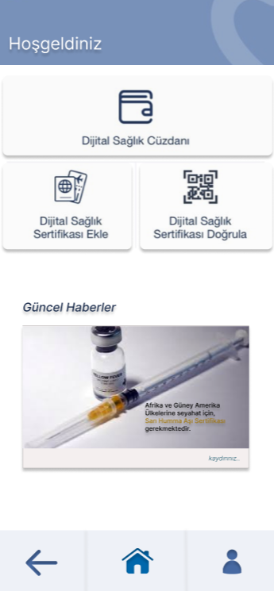
Login Page

Slide 8
Welcome Page
Problem 1: A user session is not created
Solution: A﻿ user profile button has established with back and home page buttons

Slide 9
Welcome Page
Added Extra Feature 1: A scrolling agenda box
A﻿ scrolling agenda box has added to the homepage to inform users about the health certificates, they need true info when they are planning travel

Slide 10
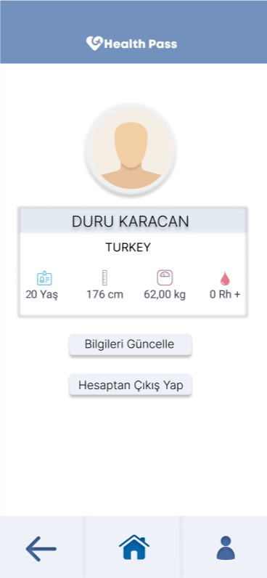
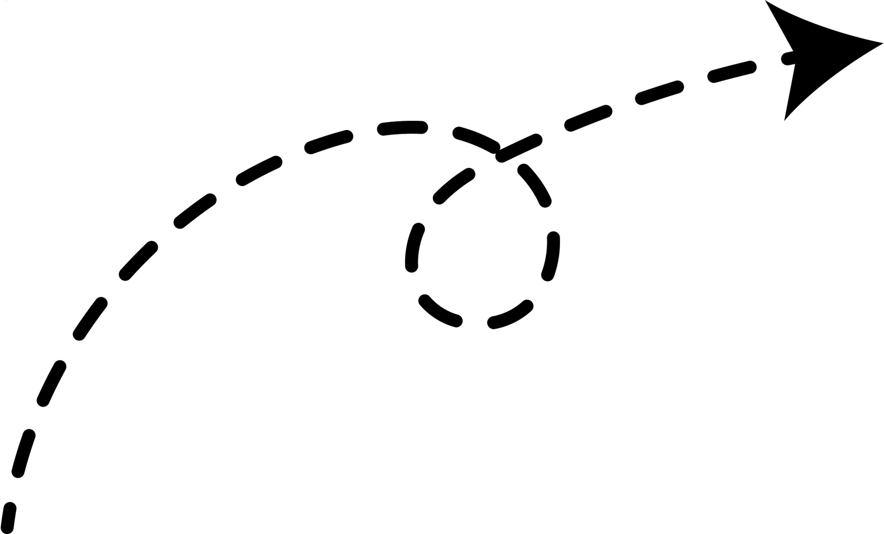
User Info Page

Slide 11
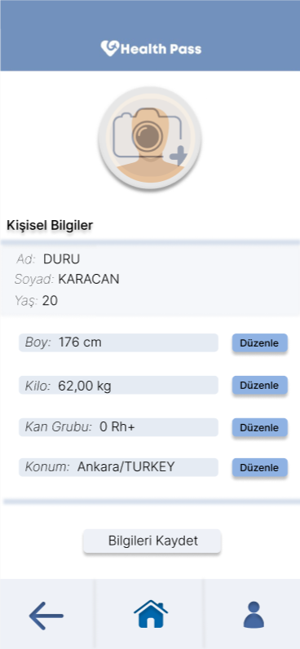
User Info Edit Page

Slide 12

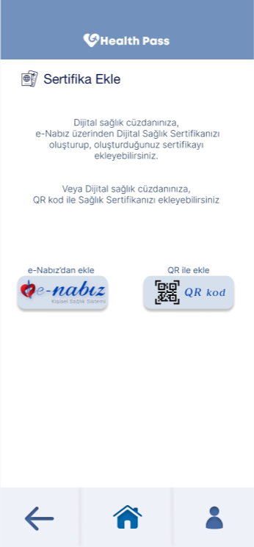
Digital Health Wallet Page
Problem 1: There is no button directing to e-Nabız.
e-Nabız button replaced with a new option which is QR kod button

Slide 13
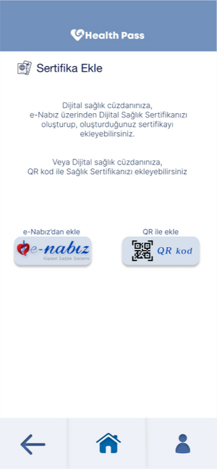
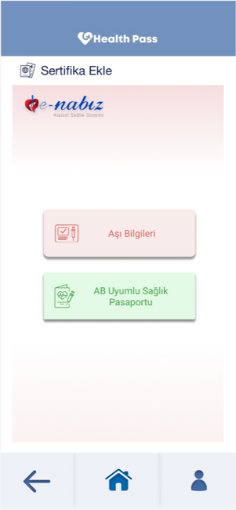
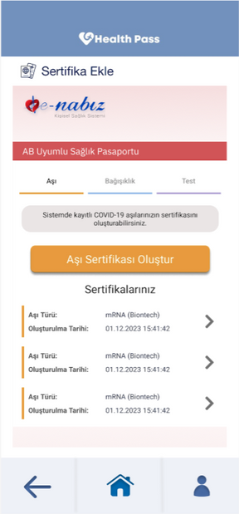
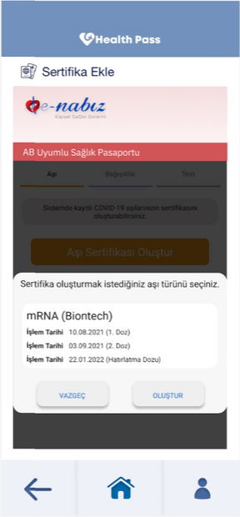
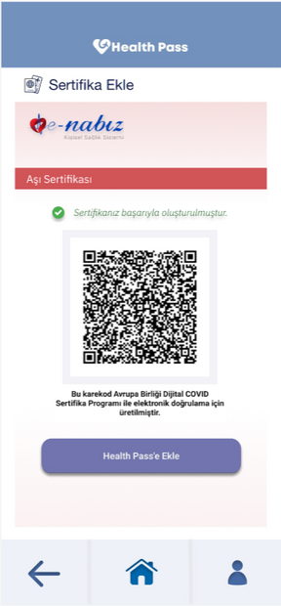

Digital Health Wallet Page
e-Nabız Process and Add Sertificate

Slide 14
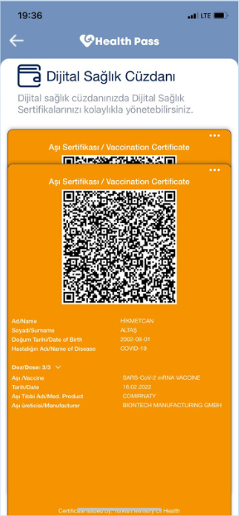
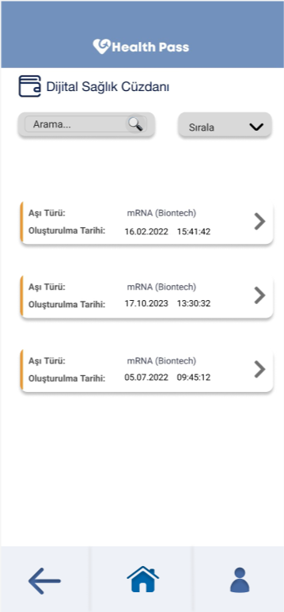
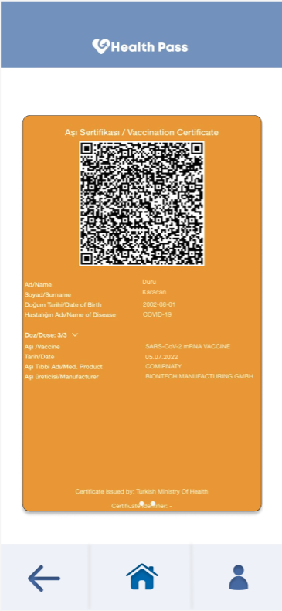
Digital Health Wallet Page
Problem 2: Challenges in Certificate Selection and Checking
new
There is no sorting and filter option and you can‘t choose the sertificate that you want directly in the last version
There is new search and sort section

Slide 15
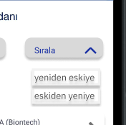

Searching and Order To-Page
You can sort your sertificates according to date or it’s validate
You can search to find your sertificate easily

Slide 16
Viewing Detail Pages

Slide 17
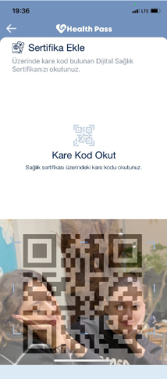
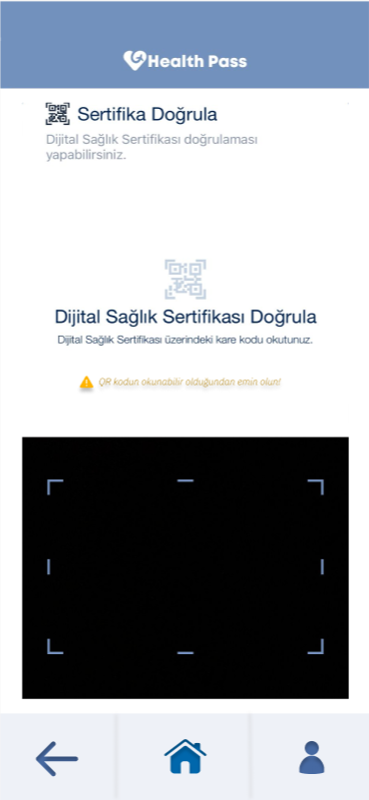
Scanning Certificate Page
Problem 1: There is no warning when the QR code is invalid
New warning top of the QR section
old
new

Slide 18
FIGMA LINK
Can View:
https://www.figma.com/file/IfUWtqvWfi4b5eEVN9BcA4/HealthPass-App-Prototype?type=design&node-id=0%3A1&mode=design&t=QNPquScImC2iyVu8-1
Can View Prototype:
https://www.figma.com/file/IfUWtqvWfi4b5eEVN9BcA4/HealthPass-App-Prototype?type=design&node-id=0%3A1&mode=design&t=QNPquScImC2iyVu8-1

